Slide 1
NIFS Exit Presentation Summer 2016
Jessica Hathaway
Notes:
Elizabeth City State University
Elementary Education Math Major

Slide 2
Overview
Locating Various Audio and Visual Equipment
Researching 360 Degree Video Conferencing Cameras
Analysis of the STEM-E and EPD
Mapping STEM-E and EPD Activities
Statistics of STEM-E and EPD Activities
LaRC and NIFS Events Attended
Lessons Learned
Future Plans
Acknowledgments
Questions

Slide 3
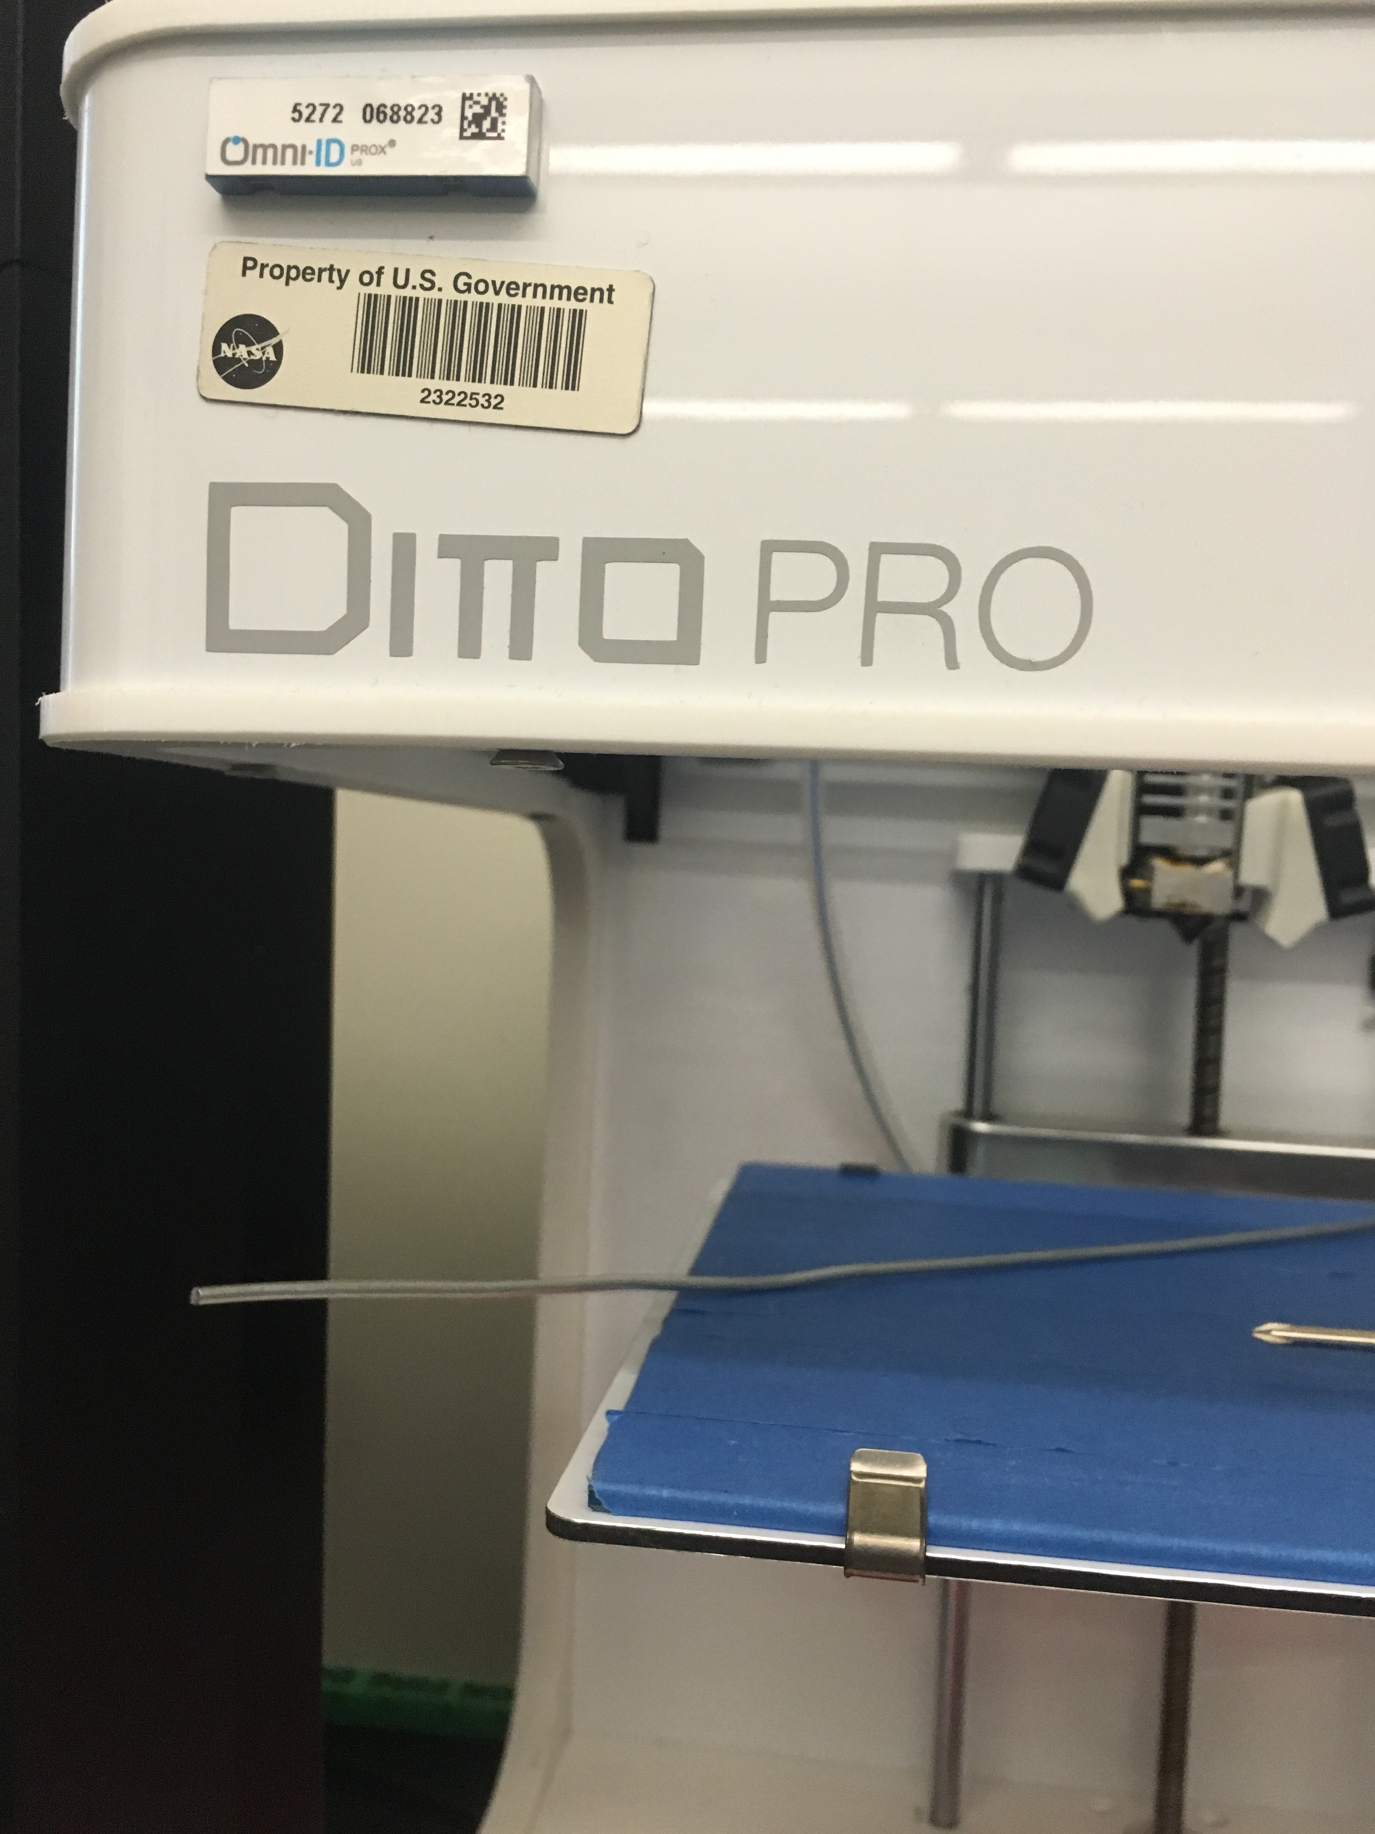
Locating Various Audio and Visual Equipment
To locate the equipment you use the ECN number that is located on the top or front of the equipment.
Location of Equipment
Studio A
Studio B
Storage Closets
Control Room
The importance of looking for the studio equipment is to be able to effectively know what items are on hand to eliminate over purchasing.
Notes:
This part of my project I worked with Michael Perri. This was to locate various audio and video equipment by using the ECN number.

Slide 4
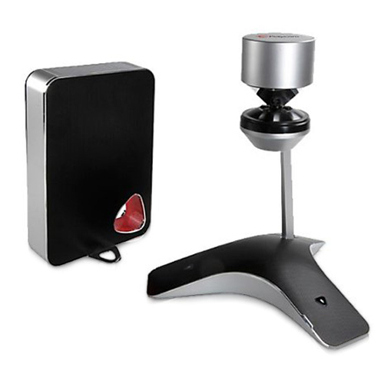
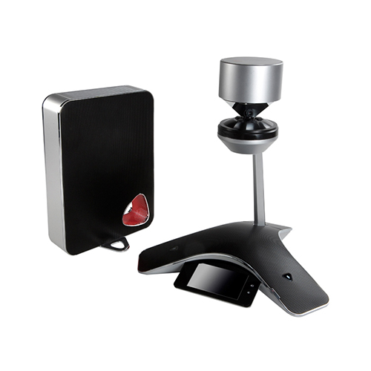
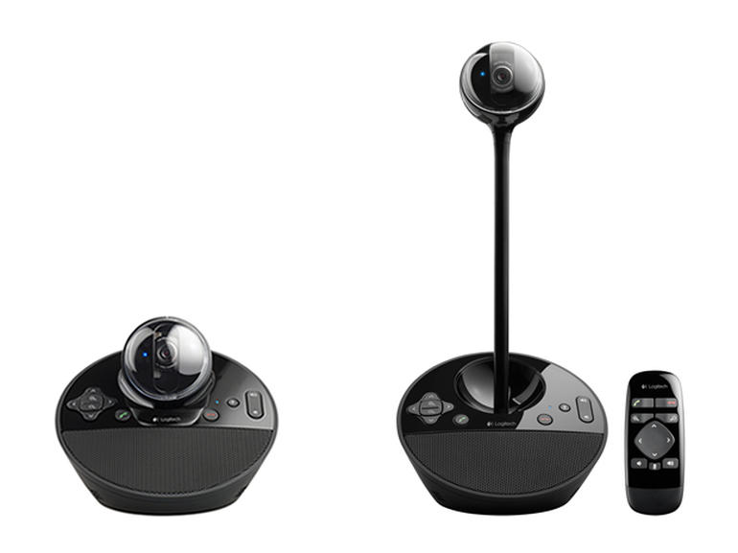
Researching 360 Degree Video Conferencing Cameras
When looking into 360 degree cameras I researched
Polycom - CX5100 Unified Conference Station
Polycom - CX5500 Unified Conference Station
Logitech BCC950 ConferenceCam
Orah 4i Live Spherical VR Camera
The use of the 360 degree camera for video conferencing can…
Notes:
How can the DLN use 360 degree Cameras for Video conferencing?
By having the camera in the middle of a large room of people so that everyone can be seen
There would not be a need to move the camera for a better angle.
Less cameras would be needed and would not have to be attached to a wall.
Portable, light weight and compatible with most video conferencing systems.
Some 360 degree cameras can be hooked to a phone, tablet or laptop.

Slide 5
Researching 360 Degree Video Conferencing Cameras (cont.)
 | USB Connectability | Built-in Microphone | Resolution | Built-In Wi-Fi | HDMI Connectability | USB 3.0 | Video Conferencing Compatibility
Polycom - CX5100 Unified Conference Station | X | X | 1920 x 288 |  |  | X | Skype for Business
Polycom - CX5500 Unified Conference Station | X | X | 1920 x 1080 |  | X | X | Skype for Business
Logitech BCC950 ConferenceCam | X | X | 1920 x 1080 |  | X |  | Skype, Jabber, WebEx, Microsoft Lync
Orah 4i Live Spherical VR Camera | X | X | 2048 x 1536 per sensor | X | X | X | Vrideo,Youtube, Wowza, Akamai, Bitmovin, Ustream, Livestream
The purpose of this chart is to show what capability each camera has.

Slide 6
Analysis of the STEM-E and EPD
Created a summary to show the frequency of the activities by:
Project name
Project type
Location
Participation by:
Teachers
Parents
Public
Students
Notes:
Dr. Alston gave me the task of creating a data analysis of stem-e and epd activities and there location. She provided me with list and list of information that I sorted throw to get what you see on the chart. So then I wanted to see what ways I could display this information.

Slide 7
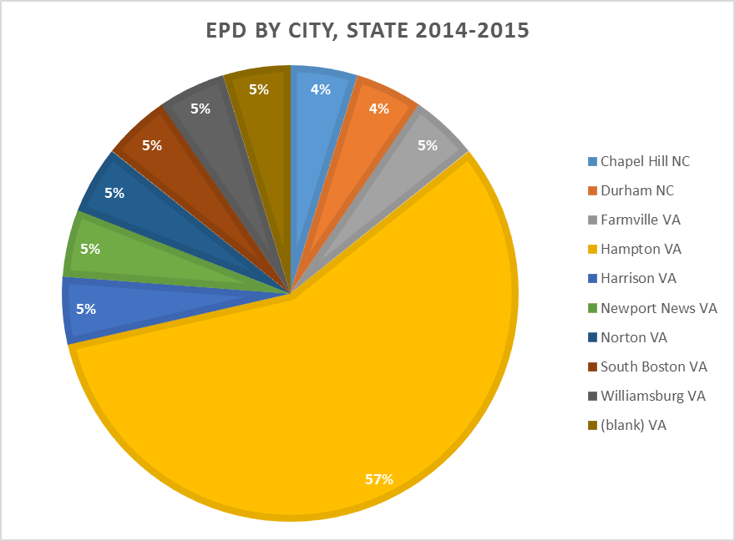
Statistics of STEM-E and EPD Activities
How were the activities displayed?
By using a pie chart the activities can be shown by what percentage of visits were spent in each city and state across the 5 state region.
Notes:
numerical

Slide 8
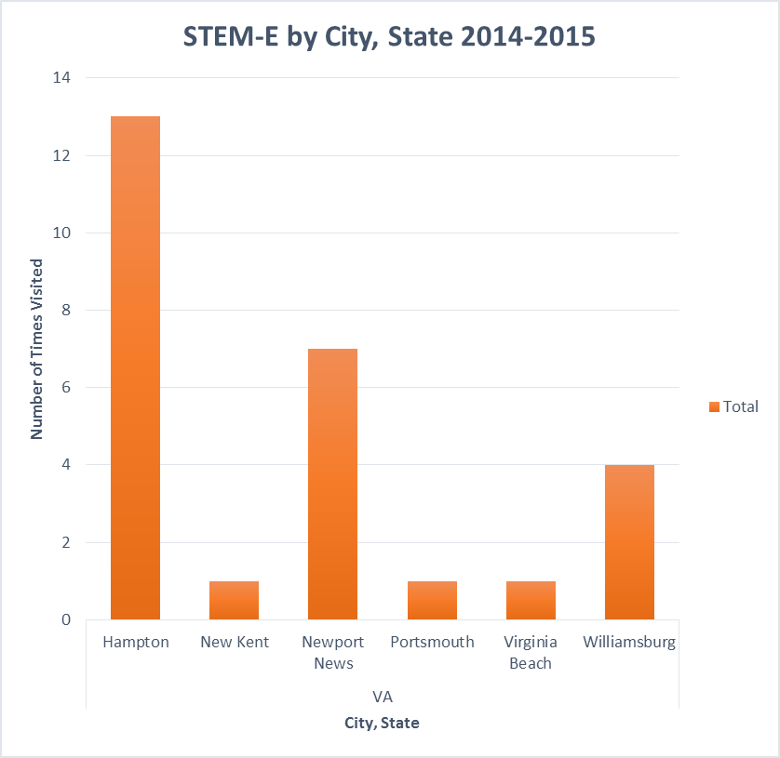
Statistics of STEM-E and EPD Activities (cont.)
How else could the activities be displayed?
By using a bar graph the activities can be organized by the number of times a state was visited.
Notes:
As you can see the most visited for both stem-e and epd was Hampton being that its local that’s expected to visits near by areas.

Slide 9
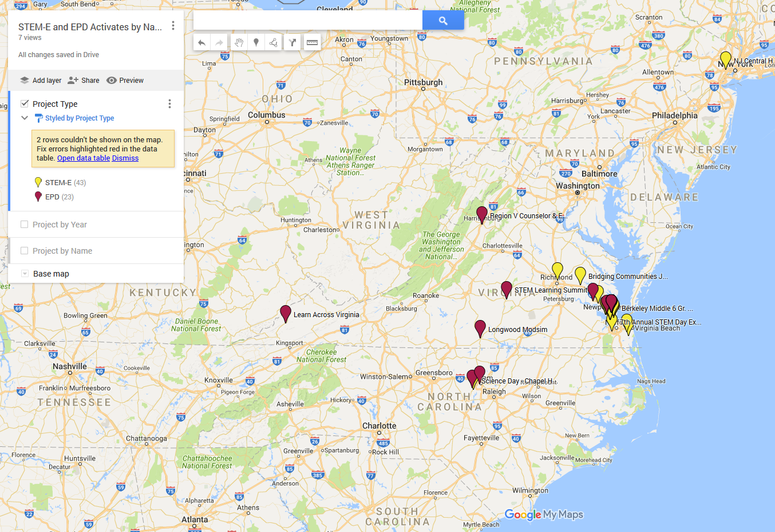
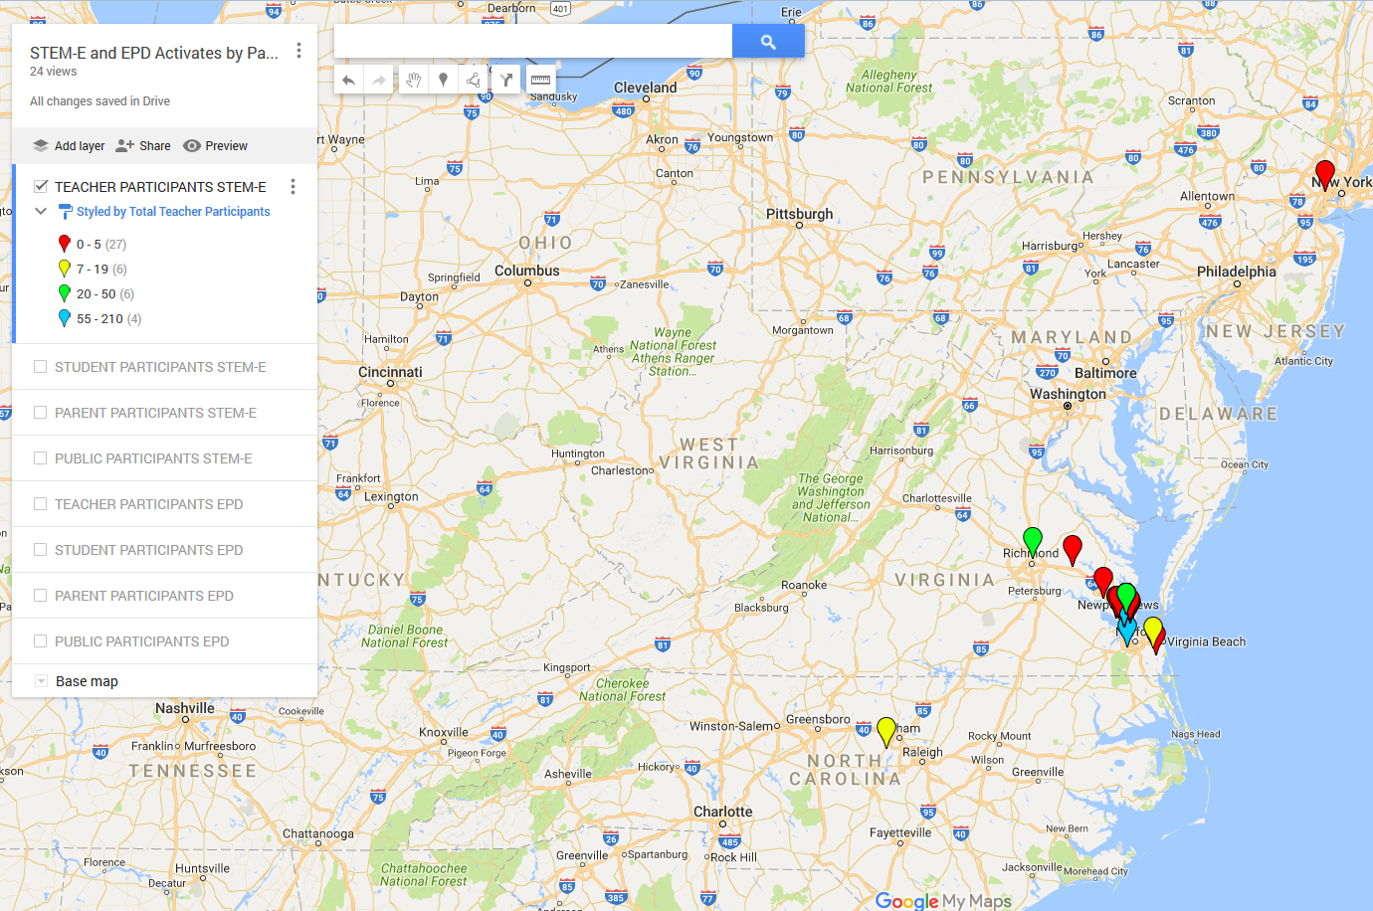
Mapping STEM-E and EPD Activities
STEM-E and EPD locations were then mapped onto the map using longitude and latitude.
Creation of layers that represent different variables such as activities by year.
By using geocoding these activities on an interactive map you are able to visualize where you have been with in the 5 state region, which assists with strategic planning of future activities.

Slide 10
LaRC and NIFS Events Attended
Hangar Tour
WIN (Women’s Informal Network)
CPR Certification
NIFS Intern Picture
Honda Jet
ACT-America at NASA Langley
Family Feud
Flight Suit Picture
Viking 40th Anniversary
Youth Day

Slide 11
LaRC and NIFS Events Attended
CPR Certification
NIFS Intern Picture

Slide 12
LaRC and NIFS Events Attended
Honda Jet
ACT-America at NASA Langley

Slide 13
LaRC and NIFS Events Attended
Family Feud
WIN (Women’s Informal Network)

Slide 14
LaRC and NIFS Events Attended
YOUTH DAY
Flight Suit Picture

Slide 15
Lessons Learned
Always come to work with an open mind.
Remember it is okay to not know what you are doing. Just make sure to ask many questions.
In writing, editing will happen multiple times.
Excel is never easy, Google helps a lot.
Make sure your project is not a school project when calling companies for information.

Slide 16
Future Plans
Start the fall semester at ECSU, I will be taking:
Abstract Algebra I
Calculus II
Intro. to Computer Science
General Physics
General Physics Lab
Interpersonal Communication
Complete my undergrad.
Take the GRE and get my masters.
Work for NASA LaRC or teach at an elementary school.

Slide 17
Acknowledgements
Dr. Gamaliel “Dan” Cherry
Dr. Erica Alston
Michael Perri
NIFS Coordinators (Christine Dillard and Valerie Ellis)
NIFS Interns (Alli, Megan, and Julius)
Would like to thank NASA LaRC for housing me here.
OEd for welcoming as part of the team.

Slide 18
Questions?

